Slide 1
Histology of Nervous Tissue

Slide 2
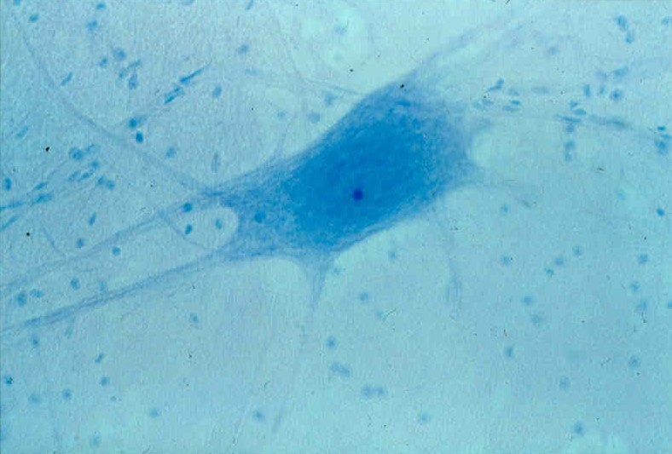
Slide of Multipolar Neuron
Nuclei of Neuroglial
or Glial Cells
Cell Body of a
Multipolar Neuron

Slide 3
Neuron: a single nerve cell (nerve fiber)
Nerve: an organ comprised of hundreds to thousands of neurons wrapped in connective tissue.

Slide 4
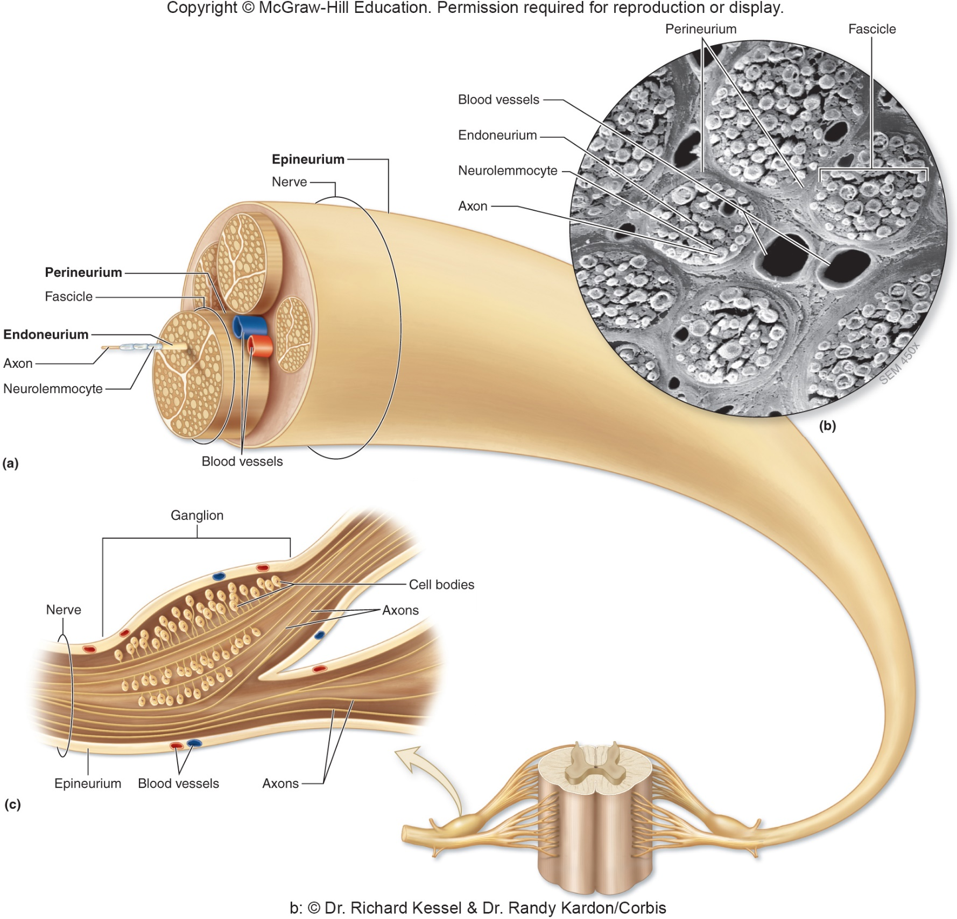

Slide 5
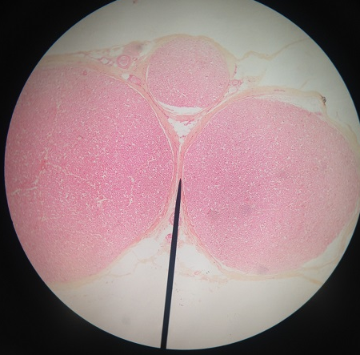
Cross Section of a Nerve Note: epineurium, perineurium, nerve fascicles
Epineurium:
Connective tissue surrounding the entire nerve organ
Nerve Fascicle:
A bundle of neurons (nerve fibers)
Perineurium:
Connective tissue surrounding the one nerve fascicle

Slide 6
Between 2 Nerve Fascicles Note: perineurium, endoneurium, myelinated axons
Perineurium:
Connective tissue surrounding the one nerve fasicle
Endoneurium:
Connective tissue in between the myelinated axons
Axon (dot)
Note the myelin sheath (white area surrounding the dot)

Slide 7
Practice Slides

Slide 8
Slide of ______________

Slide 9
Cross Section of a ________

